Slide 1
UPCYCLE ORIINALS
Minor Project-2

Slide 2
MINOR PROJECT – 2
UPCYCLE ORIGINALS
PRESENTED BY
SHRUTI SINGH
MITALI PATEWAR
SHAILY SINGH
ROHIT PRAJAPATI
GUIDED BY
PROF. SAUMYA SARASHWAT

Slide 3
CONTENTS
What is P-waste?
About our website
Technology used
Methods of recycle of P-waste
Why P-waste management
Aim

Slide 4
What is P-waste
It is the process of recovery of plastic waste and reprocessing them to create products that are functional and useful. The goal of plastic recycling is to eliminate plastic pollution by taking out plastics from the ocean and landfills as well as conserve resources in the process. What’s mind-blowing is that recycling plastic requires 88% less energy than manufacturing plastics. Furthermore, recycling a single plastic bottle can provide a 100W bulb, enough power to last for an hour.

Slide 5
ABOUT
A plastic bottle website could be developed with the aim of promoting the use of eco-friendly and sustainable packaging solutions. The site would inform visitors about the impact of plastic waste on the environment, and provide information on alternative products that can be used to replace traditional plastic bottles .
The website could also feature a range of eco-friendly and recyclable beverage containers made from materials such as glass, aluminum, and biodegradable plastics. It would include product descriptions, images, and pricing information, as well as details of the environmental benefits associated with each product.

Slide 6
SERVICES
01
SELL PLASTIC WASTE
02
Buy Upcycled Products
JOIN US For Cleaning Events
03
04
Exchange Plastic Products

Slide 7
RECYCLING IS THE RIGHT THING TO DO

Slide 8
What is Plastic Recycling
It is the process of recovery of plastic waste and reprocessing them to create products that are functional and useful. The goal of plastic recycling is to eliminate plastic pollution by taking out plastics from the ocean and landfills as well as conserve resources in the process. What’s mind-blowing is that recycling plastic requires 88% less energy than manufacturing plastics. Furthermore, recycling a single plastic bottle can provide a 100W bulb, enough power to last for an hour.

Slide 9
PLASTIC RECYCLING

Slide 10
The Plastic Recycling Process . There are multiple plastic recycling processes and each one is based on the type of plastic or the type of plastic product. However, the simplest plastic recycling processes include the following:-
PLASTIC RECYCLING PROCESS
● Collecting
The first step involves collecting plastic waste from communities.
● Sorting
Plastic waste is then sorted by their respective types and if they are recyclable or not.
● Shredding
Involves shredding of the waste into flakes.
● Washing
After shredding, the plastic flakes are soaked in hot water to eradicate contaminants.
● Melting
Involves heating the plastic to a melting point so that it can be processed into granules.
● Pelletizing
Involves the molding of plastic to form the desired product.

Slide 11
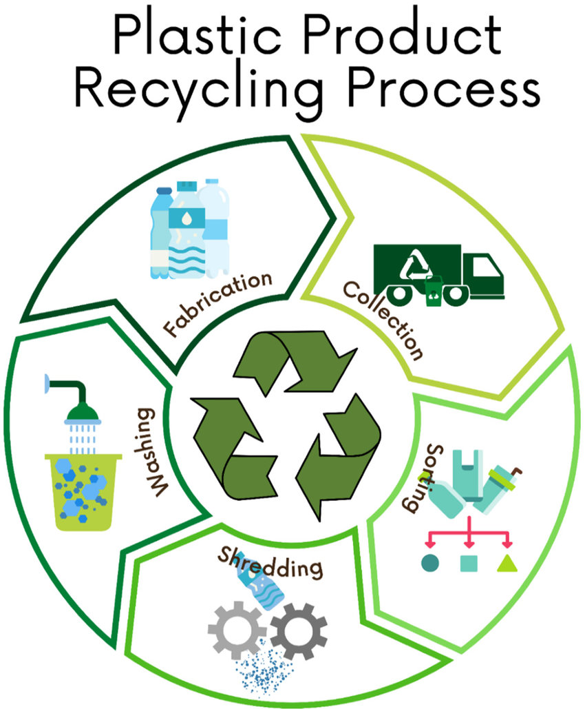
PROCESS

Slide 12
Technology Used
FRONT-END
BACK-END
HTML
CSS
JAVASCRIPT
PHP
MONGODB

Slide 13
OUR WEBSITE

Slide 14
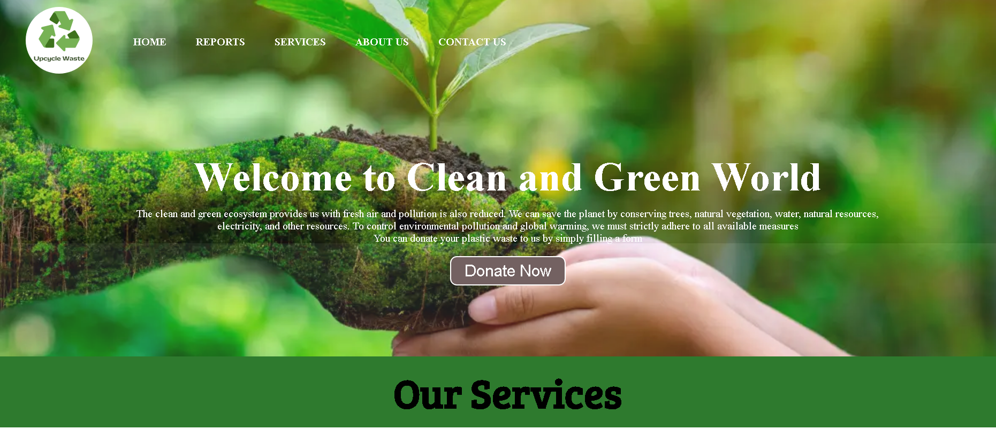
PAGE-1

Slide 15
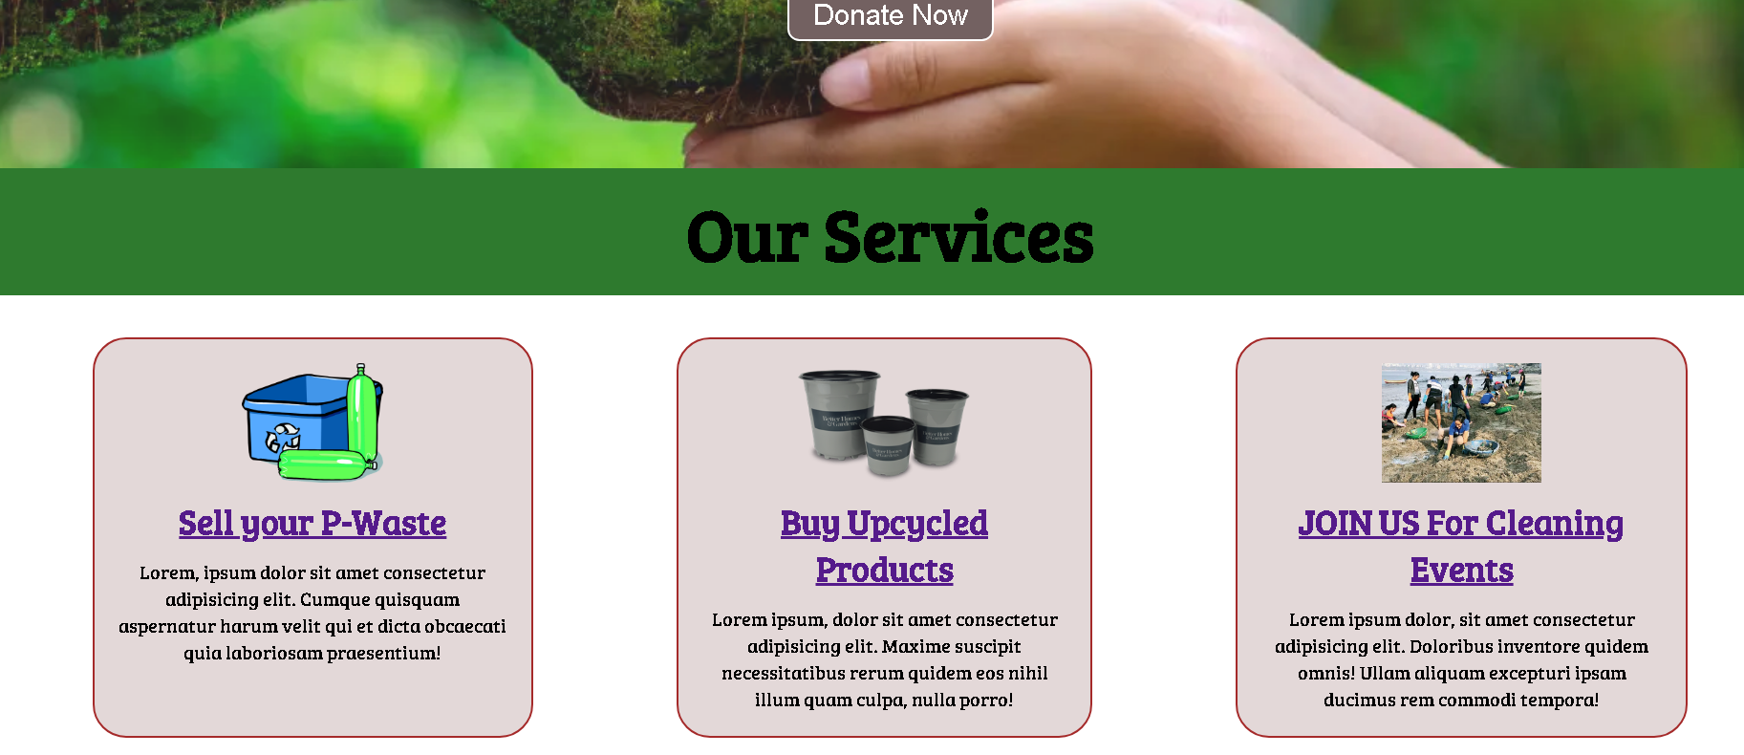

Slide 16
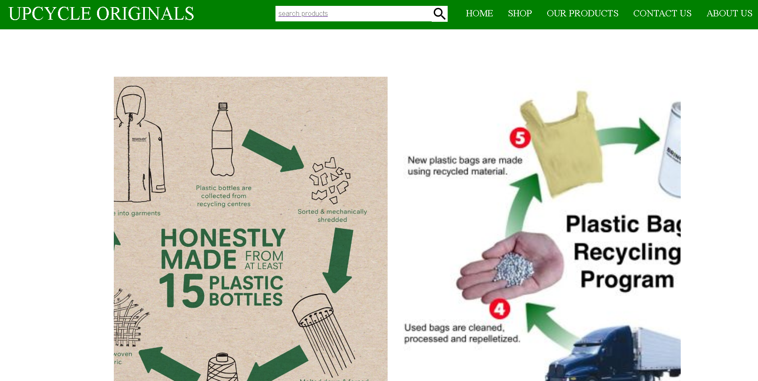
BUY UPCYCLED PRODUCT

Slide 17
